Slide 1



CSE 298 – Foundations of Robotics
Lecture 9 – A*

Slide 2
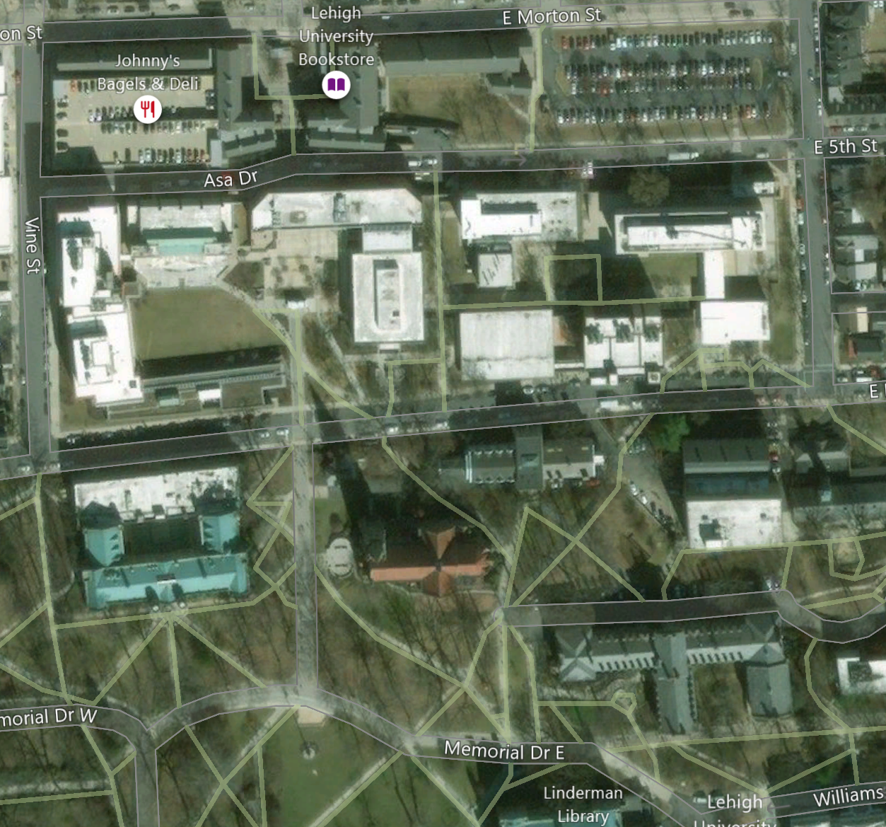



Slide 3


Slide 4


Slide 5


Slide 6


